Slide 1
Competitive Programming
14 Sep. 2023
Andrei Novikov

Slide 2
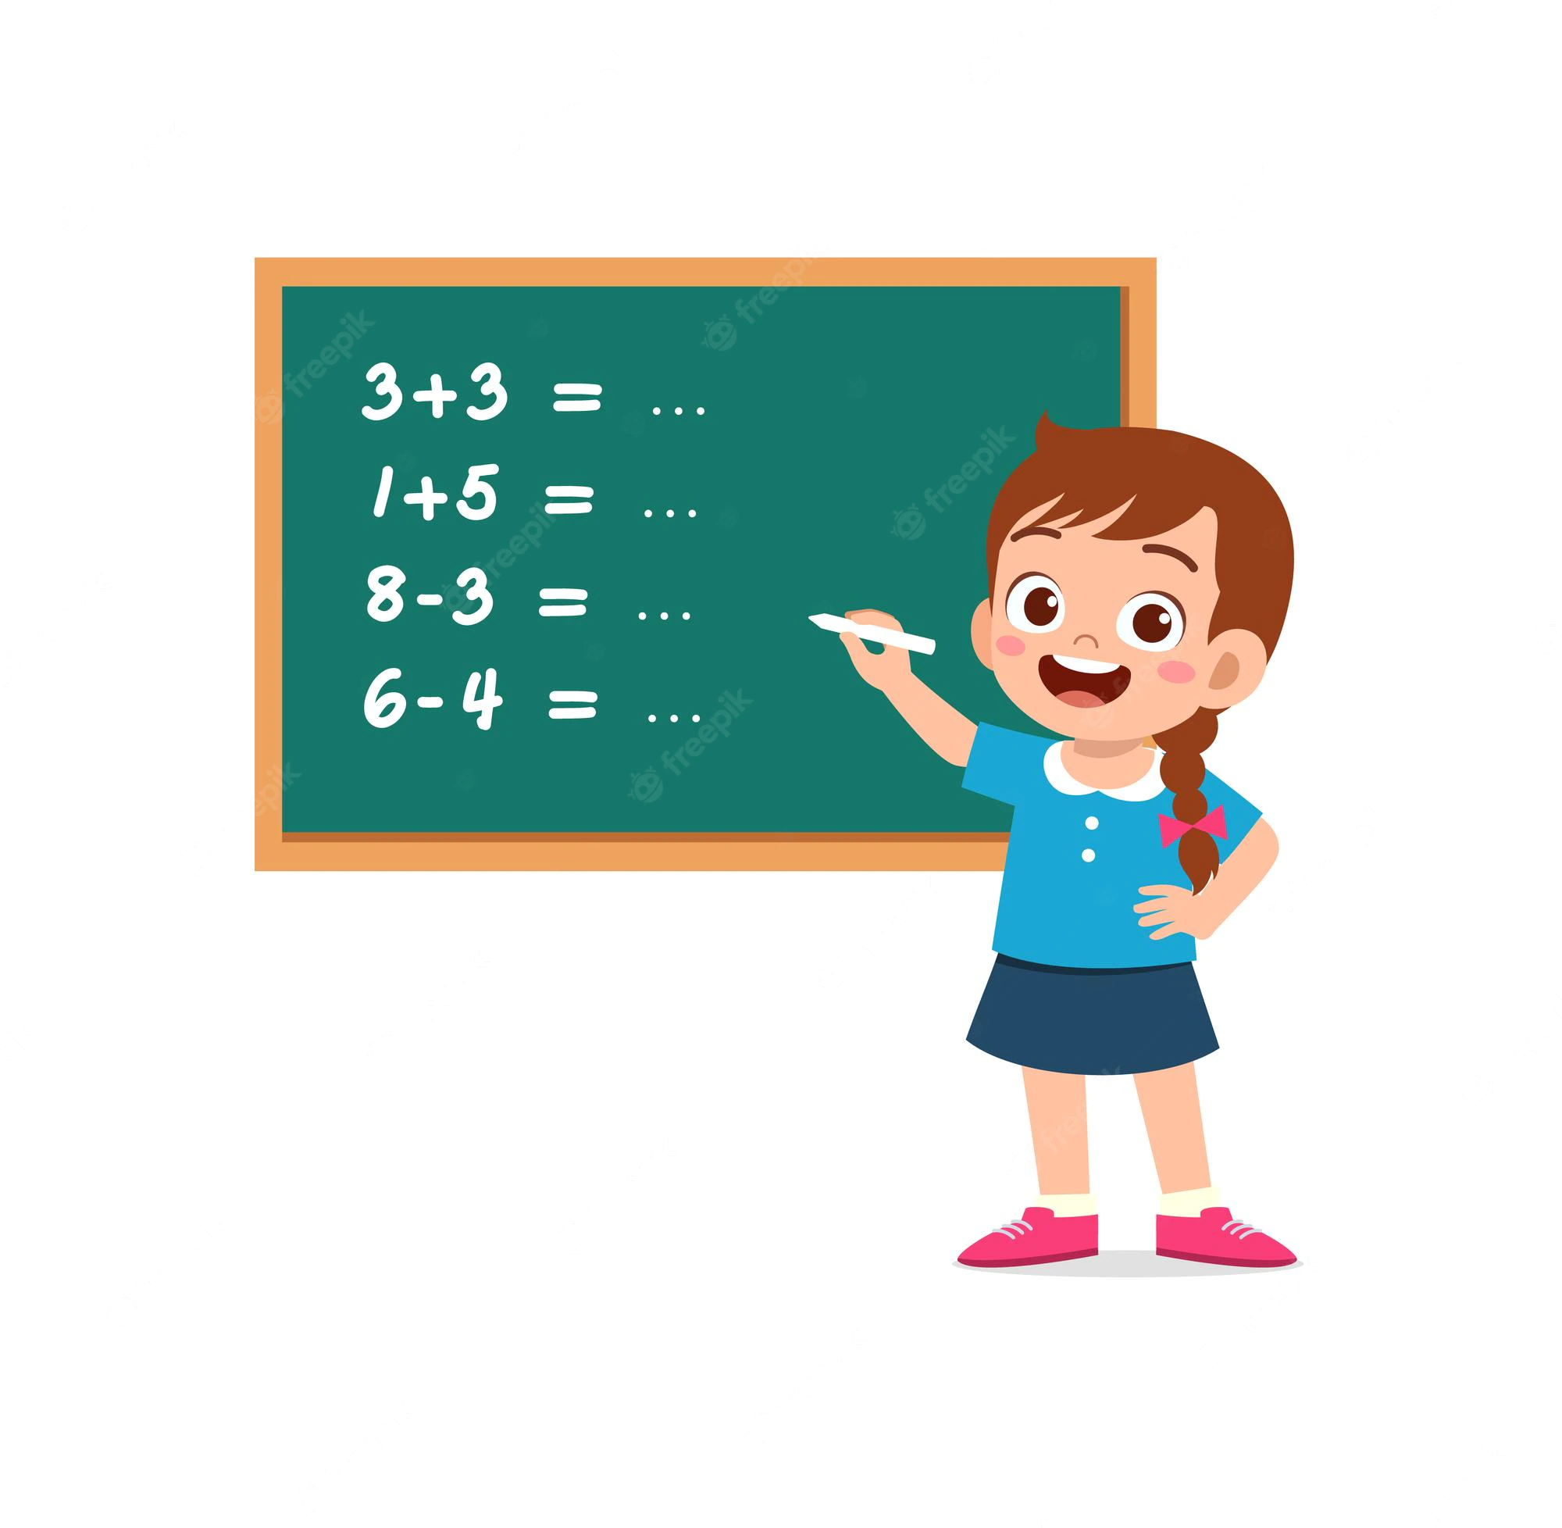
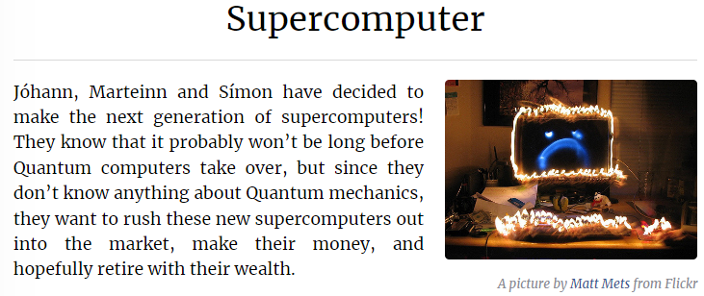
Practice – Look at the Problem
Let's look into the problem and discuss how to solve it:
Kattis. Supercomputer – Link

Slide 3
Question to think
Suppose we have an array: [ 2, 4, 5, 1, 0, 5, …, ki], where ki ∈ Z (any integers).
How efficient to get sum in ranges?
For example, sum of range (1, 5) = 4 + 5 + 1 + 0 + 5 = 15 and (7, 10).
What if the array can be updated at any time?
How efficiently update a region by the same value?
For example, by +10 to elements in range (1, 4) to get [ 2, 14, 15, 11, 10, 5, …].

Slide 4
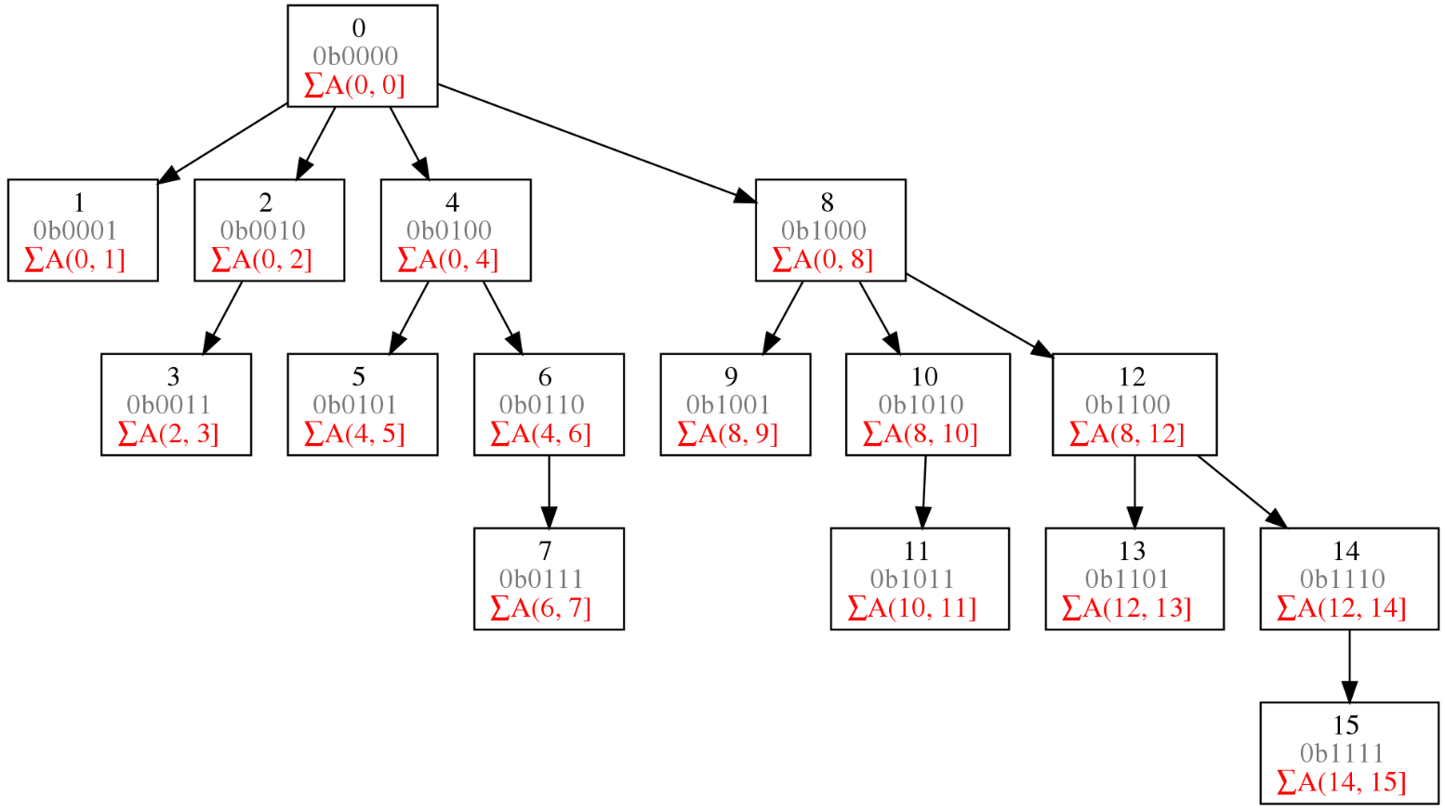
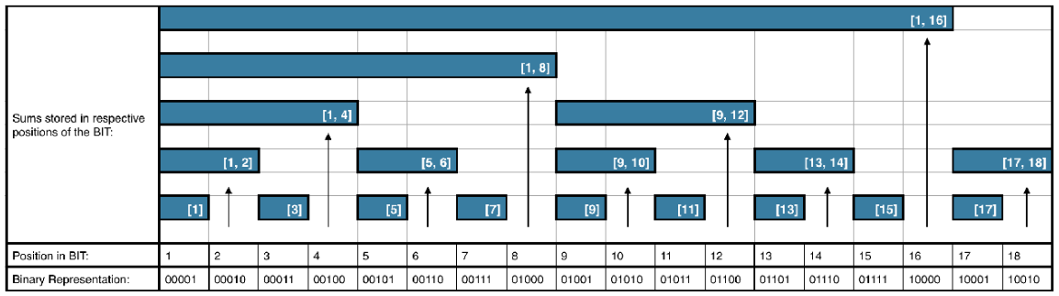
Binary Indexed Tree
There is a special structure to solve the mentioned problems that is called Binary Indexed Tree.

Slide 5
Practice – Now Solve the Problem
Solve the problem:
Kattis. Supercomputer – Link

Slide 6
Where to read about Binary Indexed Tree?
Competitive Programming 4
Chapter 4. Chapter 2.4.3.

Slide 7
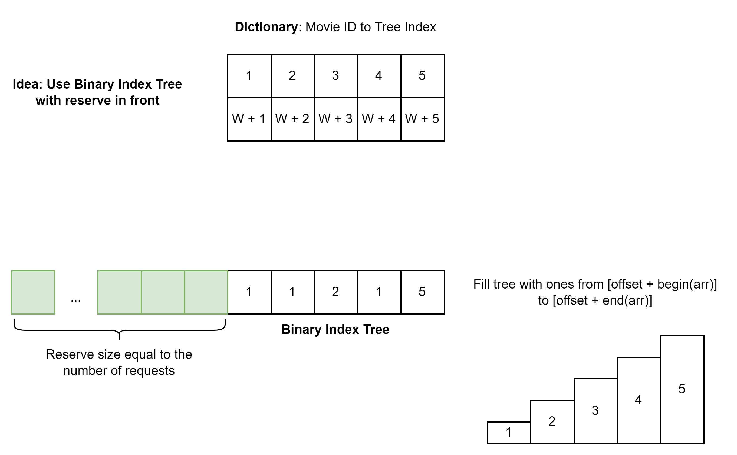
Hometask to practice
The aim of the hometask is to practice usage of Binary Indexed Tree.
Kattis – Movie Collection – Link
Tips and Hints
Use Binary Indexed Tree to count elements in front of it – O(log(N))
Use dictionary (array) to map movie ID to its position in the tree – O(1)
Reserve memory in front of the tree to move elements – O(log(N))

Slide 8
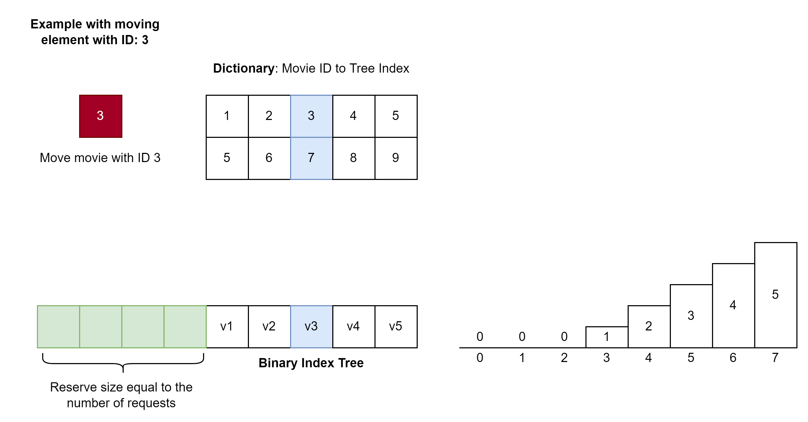
Hometask to practice
The aim of the hometask is to practice usage of Binary Indexed Tree.
Kattis – Movie Collection – Link
Example to move movie with ID: 3

Slide 9
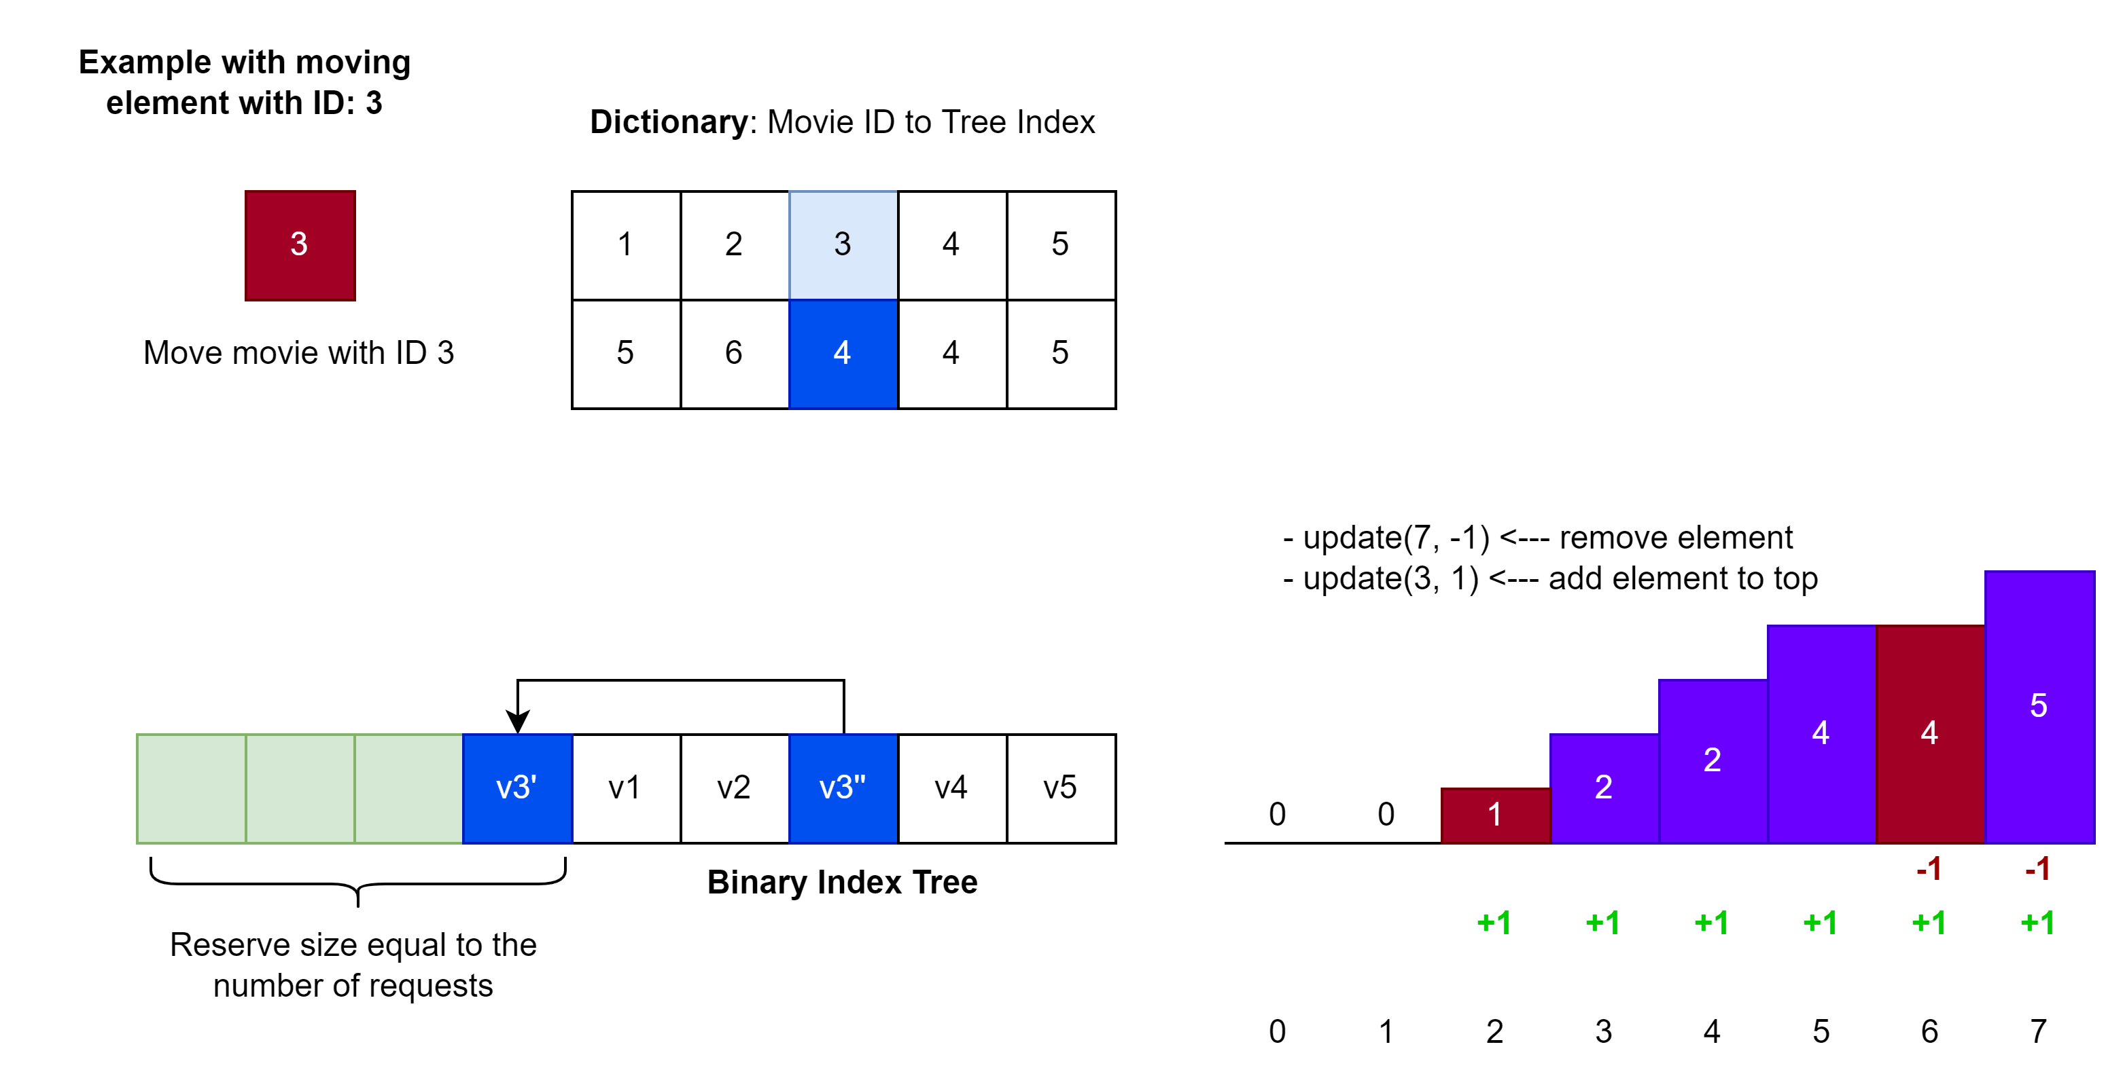
Hometask to practice
The aim of the hometask is to practice usage of Binary Indexed Tree.
Kattis – Movie Collection – Link
Example to move movie with ID: 3

Slide 10
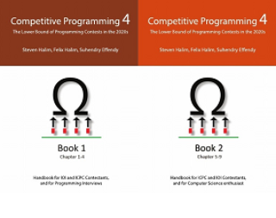
How to Learn and Practice
As one of the recommendation is to use:
Book Competitive Programming 4
Kattis – Link
Online Judge – Link
LeetCode - Link
Few Theory
A Lot of Practice
A Lot of Theory
Almost No Practice

